Slide 1

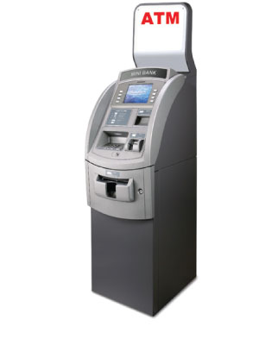
ATM Settlement and Cutover

Slide 2
What is Cutover ?
Cutover is a process to change posting day.
What is Settlement ?
Settlement use for the transaction management & reporting. Also it is reconcillation efforts.

Slide 3
BASE24-atm Settlement
The BASE24-atm logical network is cut over and settled each day. Settlement, in this context, is actually a reconciliation effort whereby the current day’s transaction activity is closed out and reported and the system is shown to be in balance.
BASE24-atm settlement is conducted in two stages:
  Institution settlement and
  Logical network settlement.

Slide 4
Defining the Network Participants
The BASE24-atm product interacts with a number of financial entities.
      Cardholders
      Card Issuers
      Terminals
      Terminal Owners
      Interchanges

Slide 5
Types od Cutover
    Terminal Cutover
      Card Balance and Cutover
      CRT Balance and Cutover
      Settlement Initiator Process Force Cutover
    Institution Cutover
    Logical Network Cutover
    Interchange Cutover

Slide 6

Cutover Hierarchy
Terminal Cutover
Institutional Cutover
Logocal Network
Cutover
PRO1
Intechange Cutover
Interchange

Slide 7
The BASE24-atm Cutover and Reporting Database
    Transaction Log File (TLF)
    Reports File (RPT)
    Interchange Log File (ILF)
Other Database Files
    BASE24-atm Terminal Data Files (ATD)
    Institution Definition File (IDF)
    Logical Network Configuration File (LCONF)

Slide 8
Terminal Cutover
Terminal Balancing
Types in Terminal Balancing
a) Balancing Terminals Once a Day
b) Balancing Terminals Multiple Times a Day
Types In Terminal Cutover
Card Balance and Cutover
CRT Balance and Cutover
Settlement Initiator Process Force Cutover

